Slide 1
Channels of Distribution in Marketing
EEM
UNIT-3

Slide 2
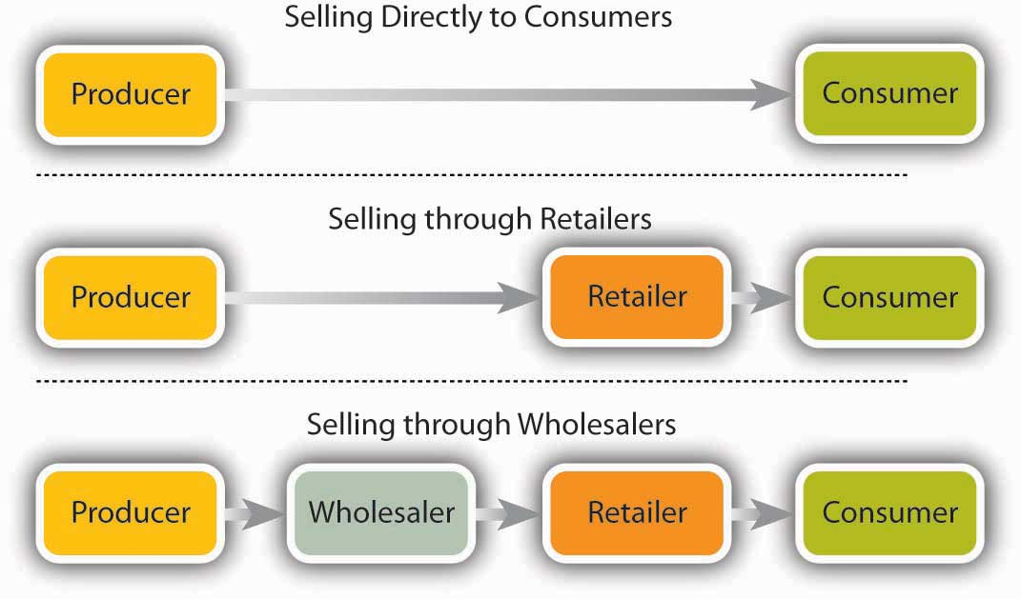

Slide 3
Channels of Distribution in Marketing
Distribution channels are pathways through which goods and services flow from the manufacturer to the end consumer.
These channels play a crucial role in marketing as they determine how products reach customers.
Here are some common channels of distribution:

Slide 4
Channels of Distribution in Marketing
Direct Selling: In this channel, the manufacturer sells directly to the consumer without any intermediaries. This can be through company-owned stores, e-commerce websites, or direct sales representatives.
Retailers: Retailers purchase products from manufacturers or wholesalers and sell them to consumers. This can include brick-and-mortar stores, online retailers, supermarkets, and specialty stores.

Slide 5
Channels of Distribution in Marketing
3. Wholesalers: Wholesalers purchase large quantities of products from manufacturers and sell them to retailers. They act as intermediaries between manufacturers and retailers, often providing storage, bulk-breaking, and distribution services.
4. Distributors: Distributors are similar to wholesalers but may focus on specific industries or product categories. They buy products from manufacturers and sell them to retailers or end consumers, often providing additional services such as marketing and logistics.

Slide 6
Channels of Distribution in Marketing
5. Agents and Brokers: Agents and brokers facilitate the sale of products between manufacturers and retailers or consumers. They do not take ownership of the products but earn a commission for their services.
6. Online Marketplaces: Online marketplaces like Amazon, eBay, and Alibaba provide a platform for manufacturers, wholesalers, and retailers to sell products directly to consumers. These platforms can reach a large audience and offer convenience for both buyers and sellers.

Slide 7
Channels of Distribution in Marketing
7.Franchising: Franchising involves the licensing of a business model and brand to third-party operators. Franchisees operate their own businesses using the franchisor's products, services, and branding, often following specific distribution guidelines set by the franchisor.
8. Dual Distribution: Some companies use multiple distribution channels to reach different customer segments or geographic areas. This can involve selling directly to consumers through company-owned stores while also using wholesalers or retailers for other markets.

Slide 8
Channels of Distribution in Marketing
The choice of distribution channel depends on various factors such as the nature of the product, target market, competition, and company resources.
A well-designed distribution strategy can help companies reach their target customers efficiently and maximize sales and profitability.

